Slide 1



Cybersecurity Solutions Powered by Proton
We provide innovative and effective cybersecurity solutions tailored to your specific needs.
by Omar Nader Ragab
id: 231005822

Slide 2
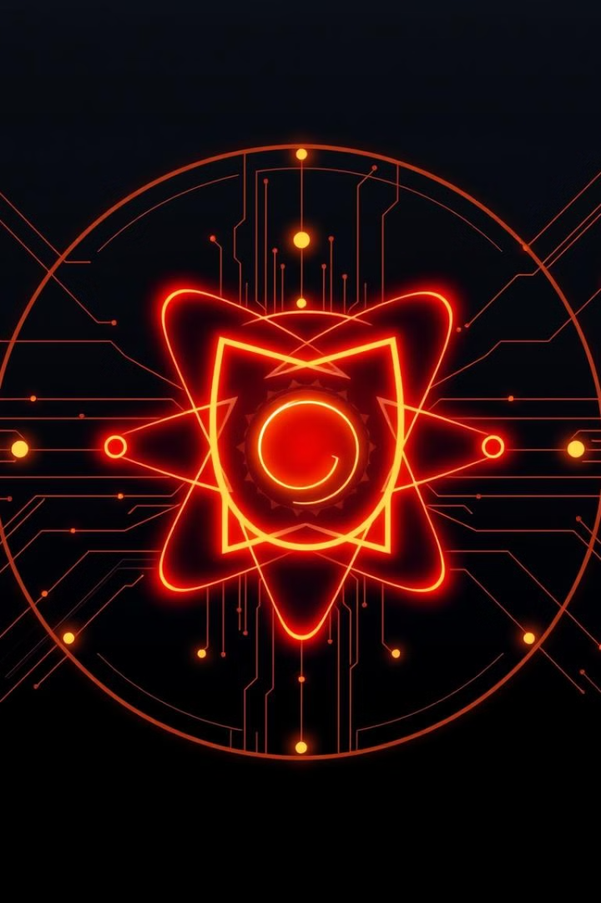
What does proton offer?
1
Secure by Design
2
Threat Prevention
Proton is a robust framework that emphasizes secure coding practices from the start.
Our approach proactively mitigates vulnerabilities and potential security risks.
3
Data Integrity
Proton ensures the confidentiality and integrity of your data, protecting it from unauthorized access.

Slide 3

About Our Cybersecurity Firm
We offer a range of cybersecurity services designed to safeguard your business, systems, and data.
Our design: our design is futuristic and it depends on the color that represents technology which is blue and red like the threat alert

Slide 4

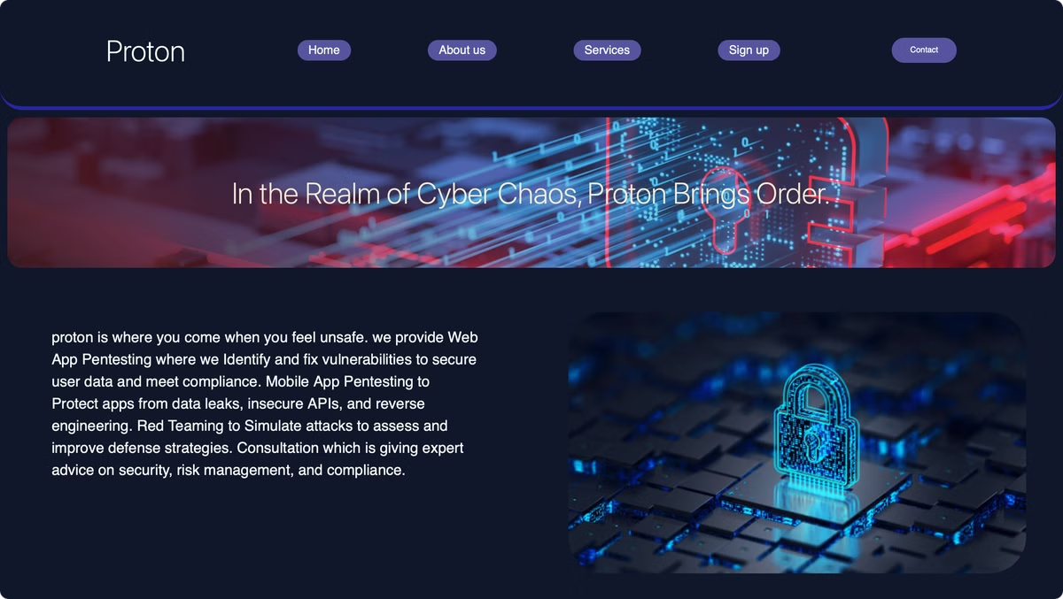

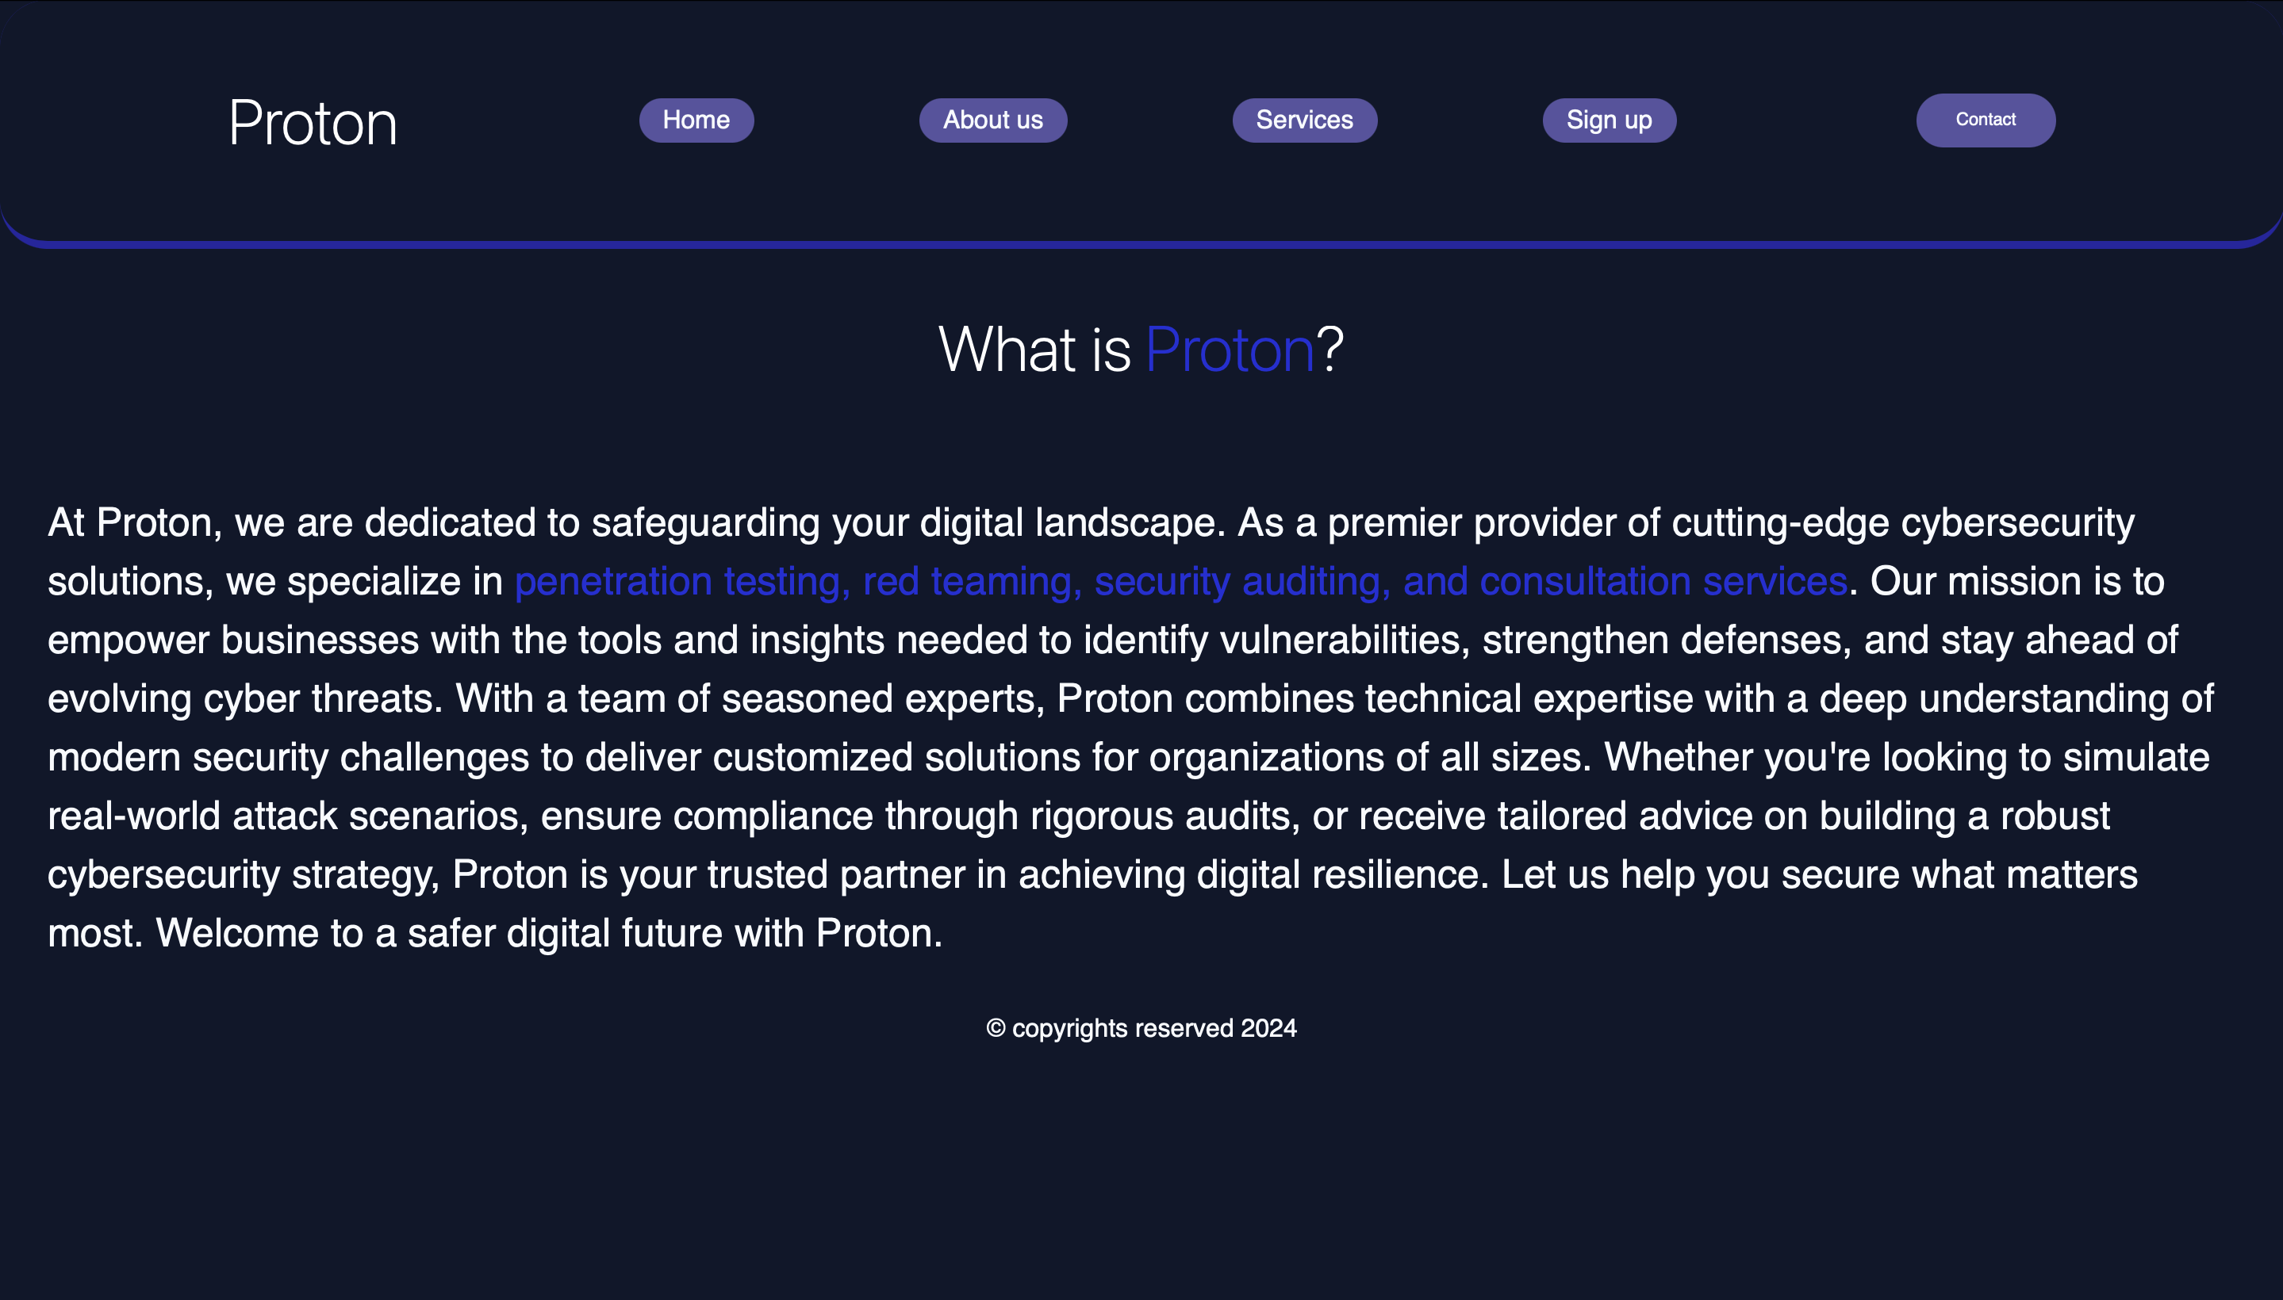

HTML and CSS
Home page
Basic home page with navigation bar and slogan and why you should choose us
We used normal <header> element in HTML and styled it to be a navigation bar
About us
Talks about what is proton and what its goals to business

Slide 5
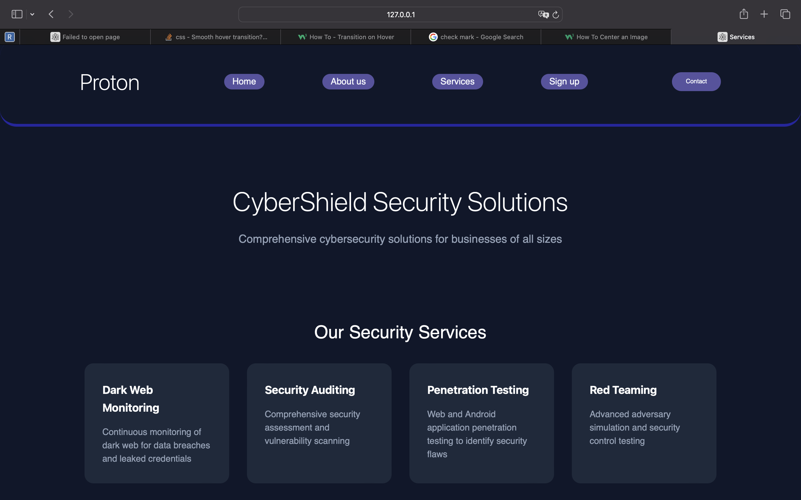
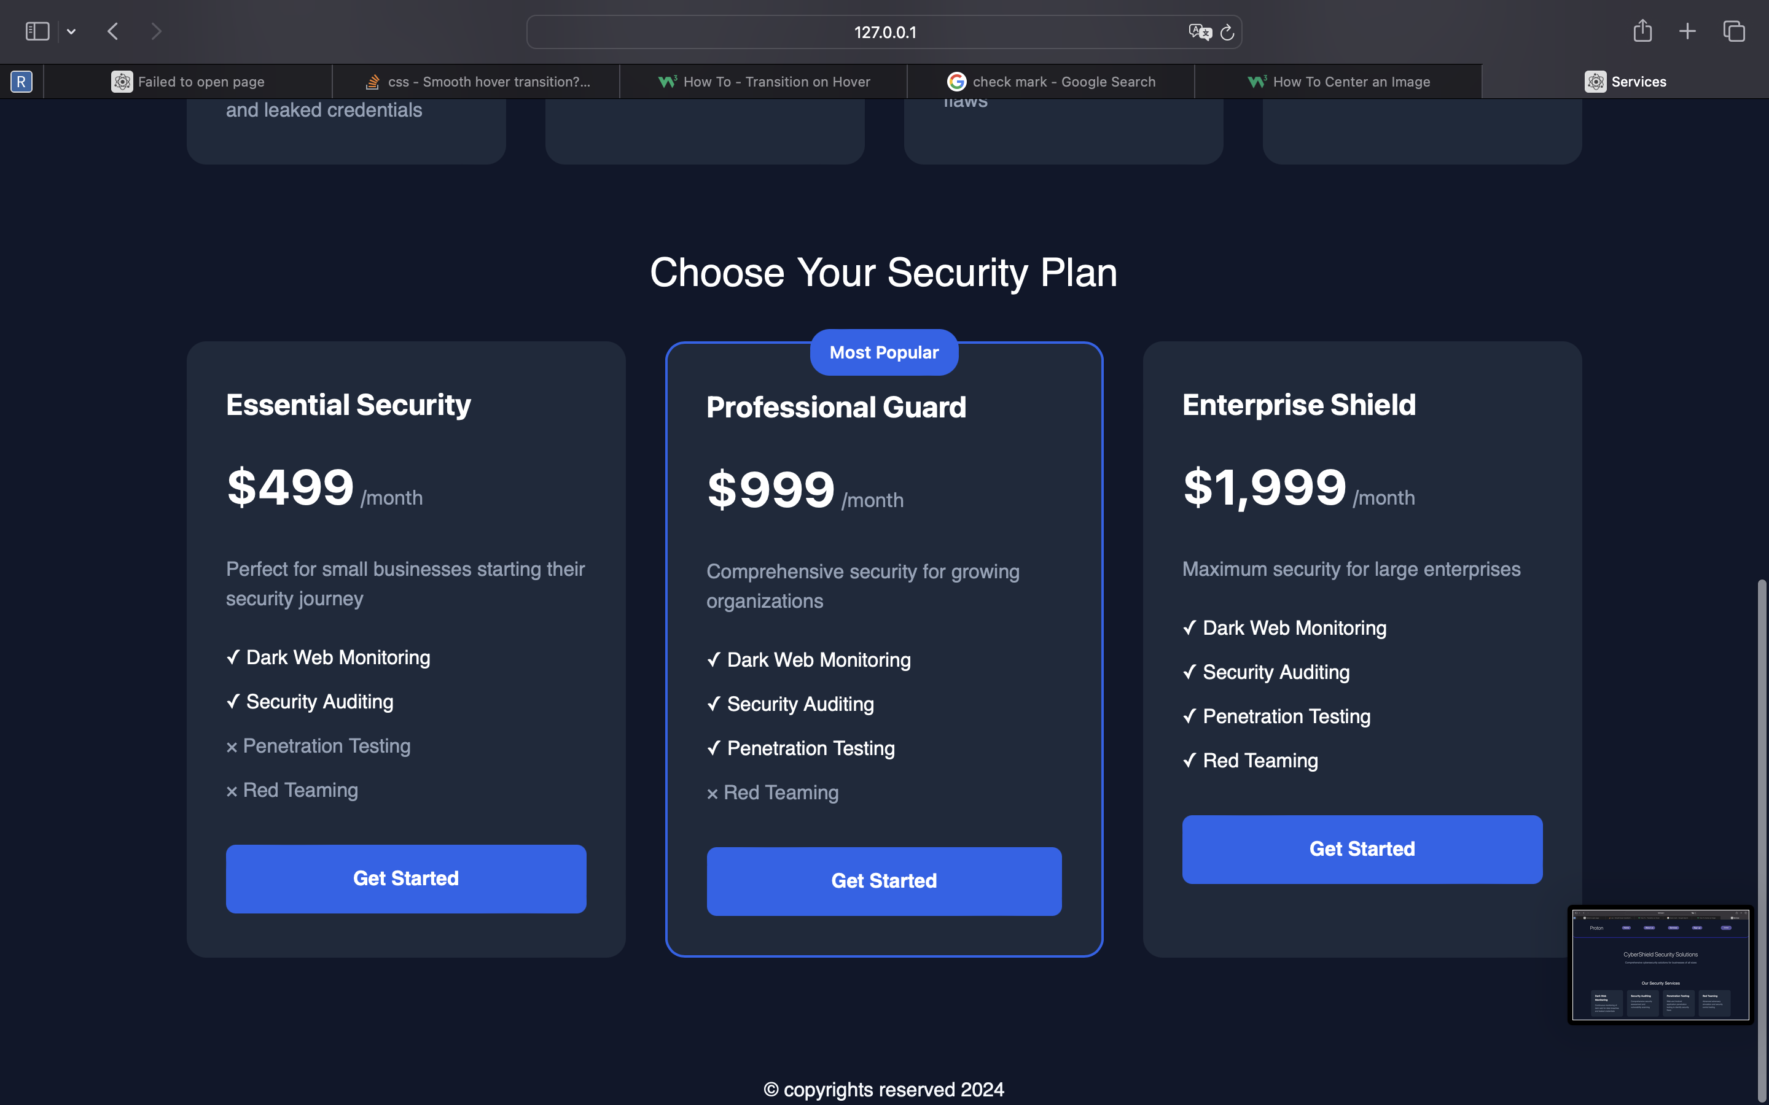

Services page.
Describing our services
Using grid CSS, we explained our services and what does it do
Grid helped in the design to make stable container and design it easily
Choose your security plan
You can use your security plan and the prices of it also with CSS grid
Classifying the subscription
We classified our subscriptions and what is the differences

Slide 6
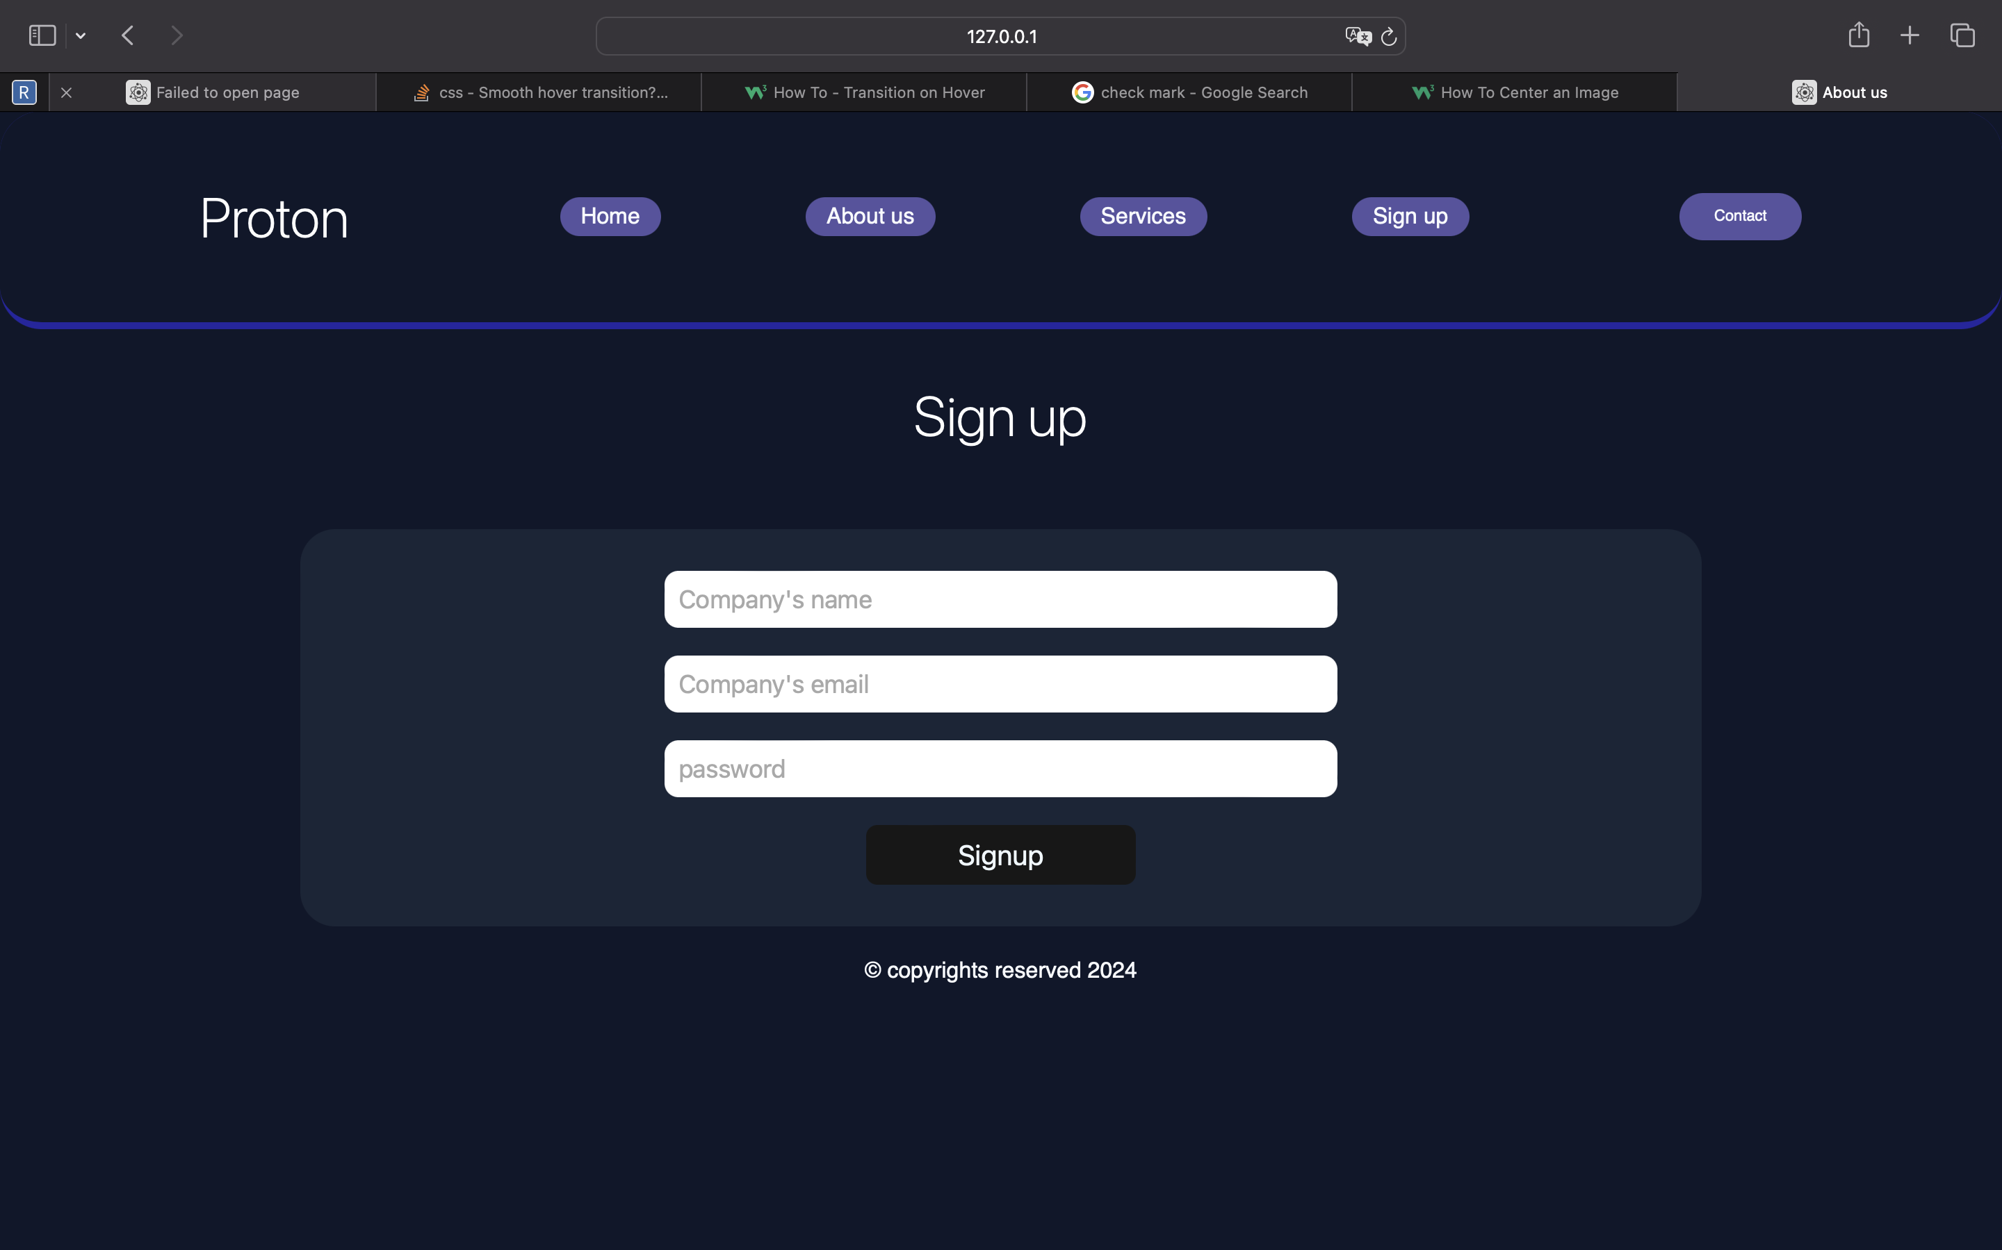
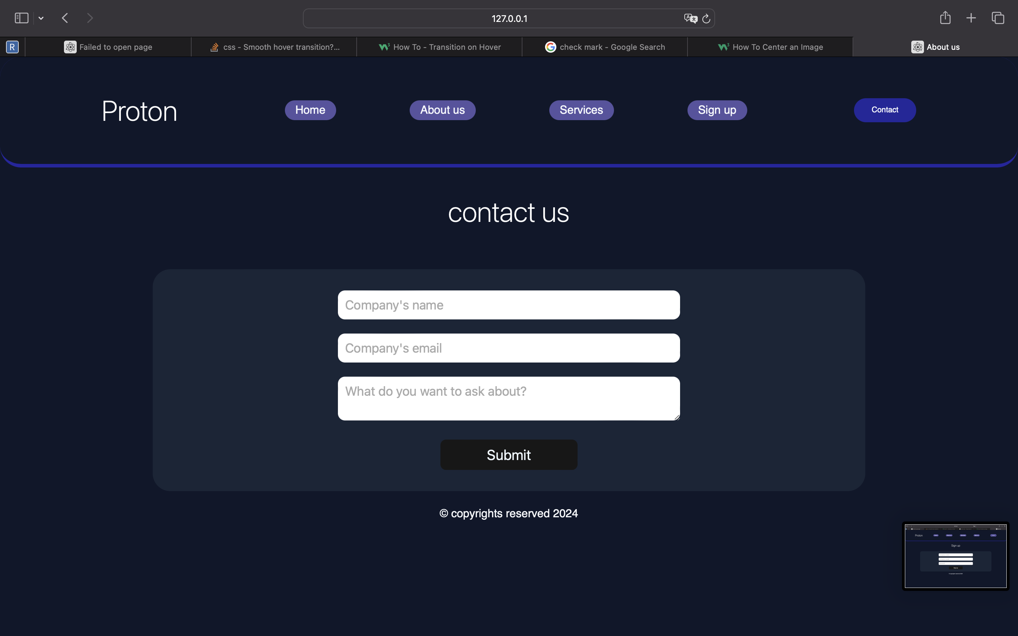

Forms.
Sign up
Contact us
Using form in HTML I made a sign up form. Our business is mostly B2B so we expected companies to sign up
Because we are a B2B business we made a contact us page to consider of anyone wanted support

Slide 7
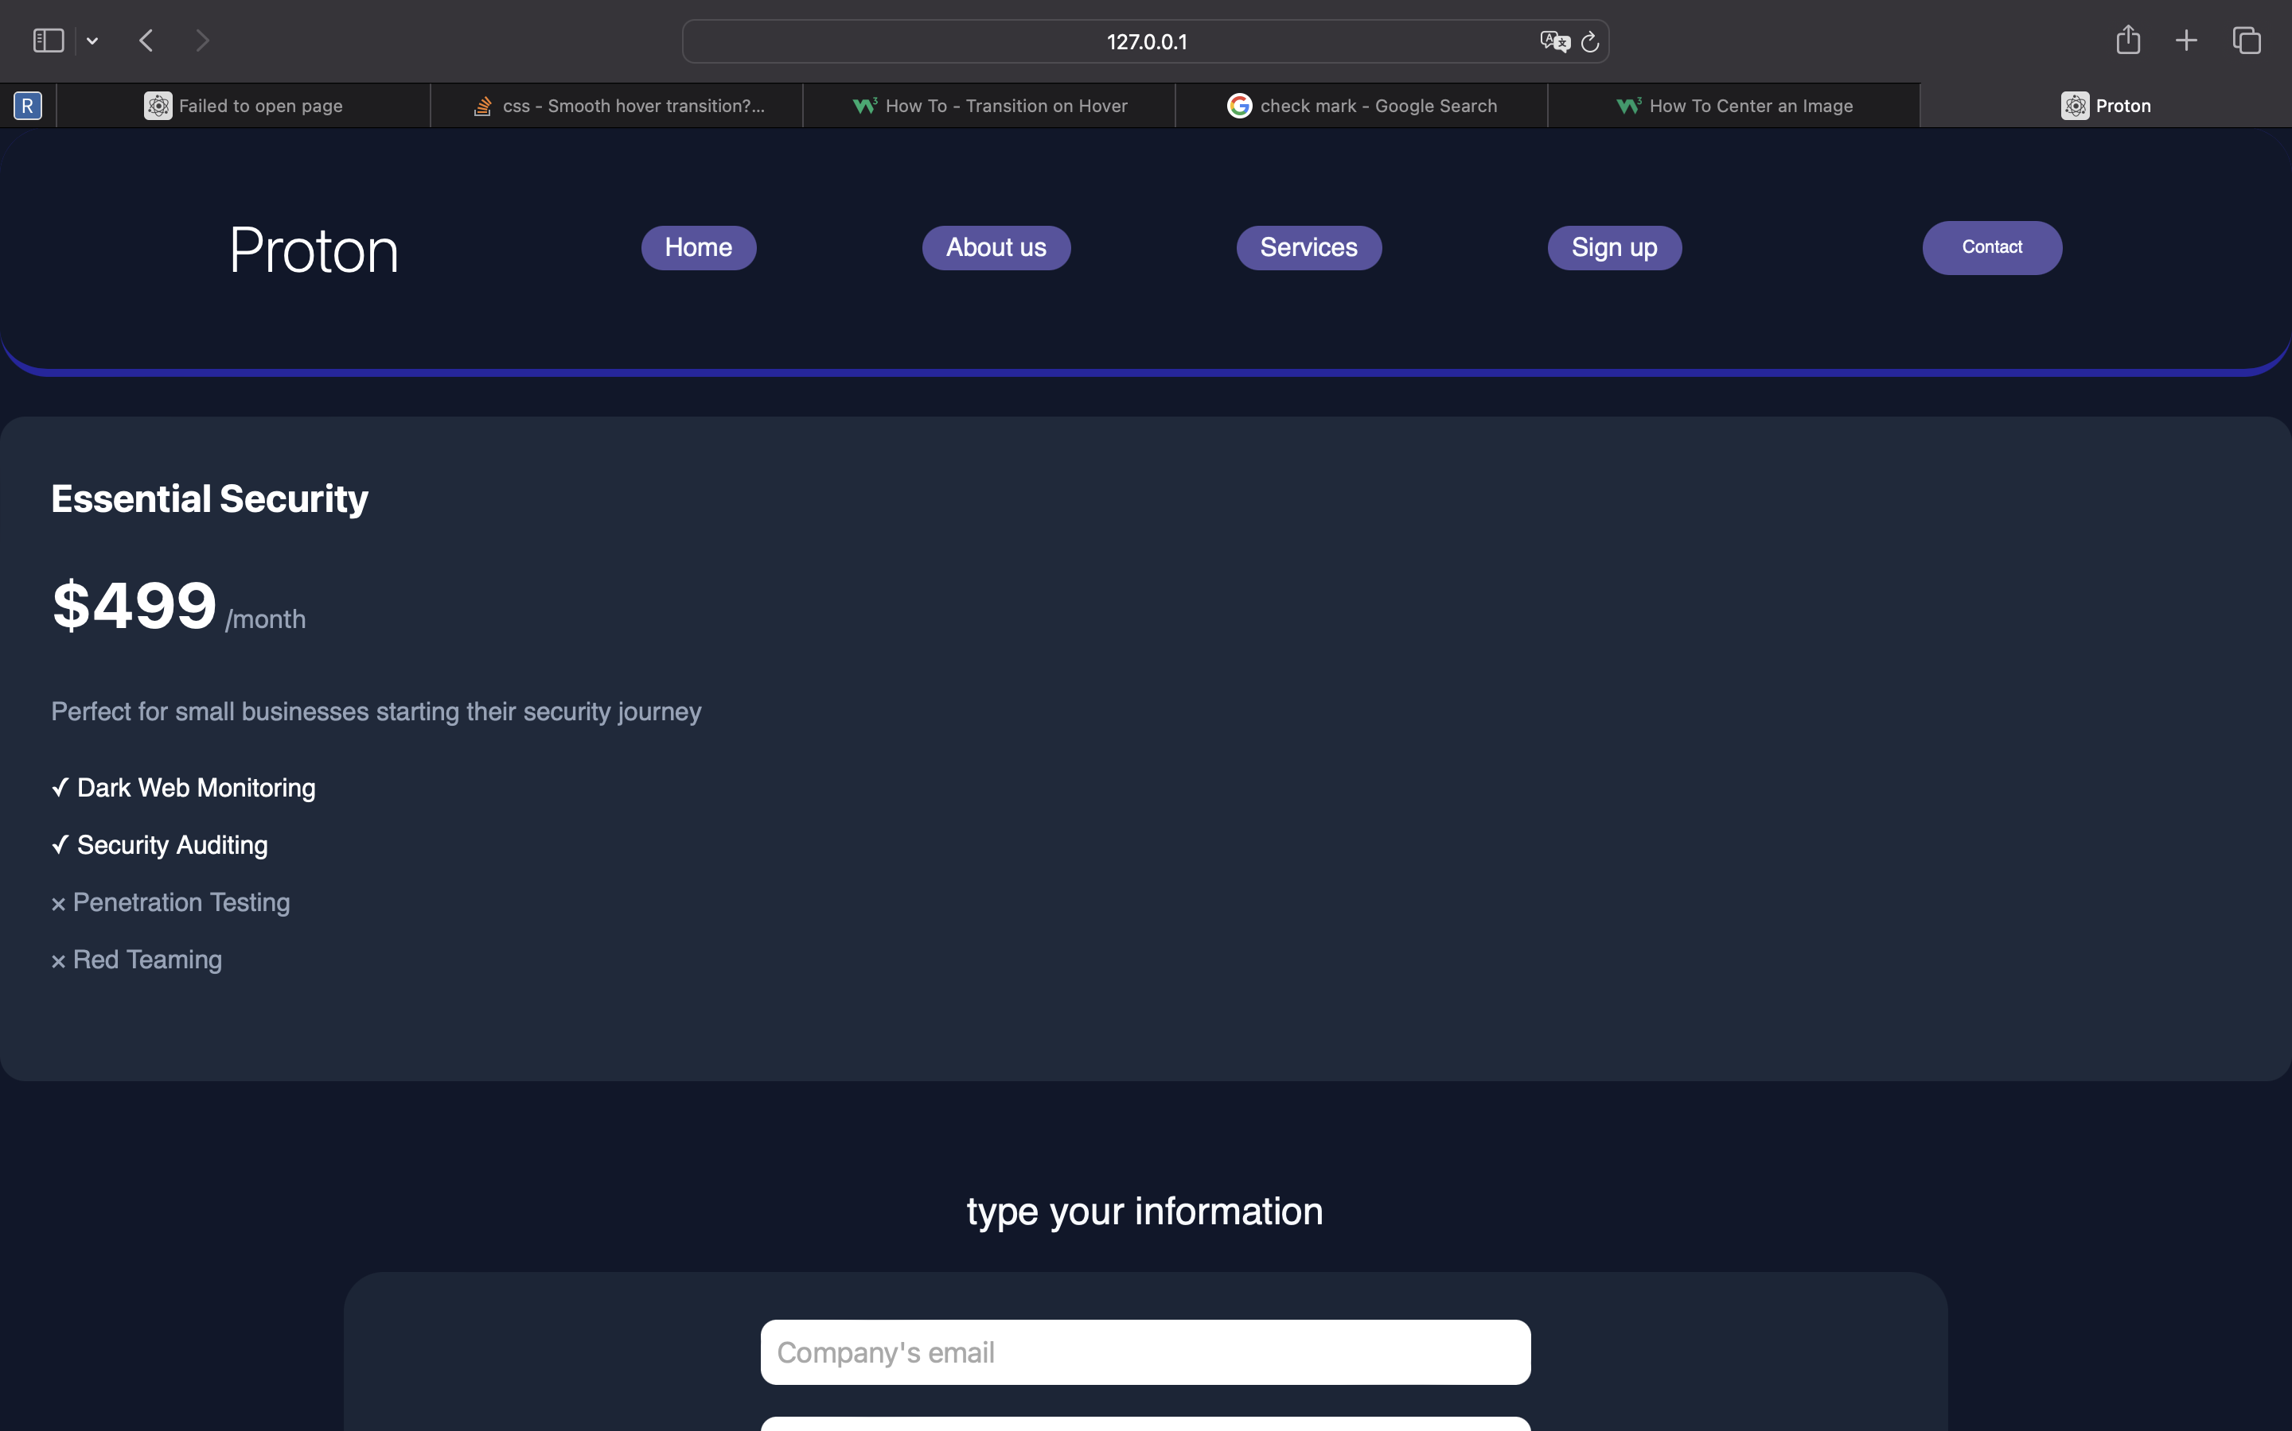
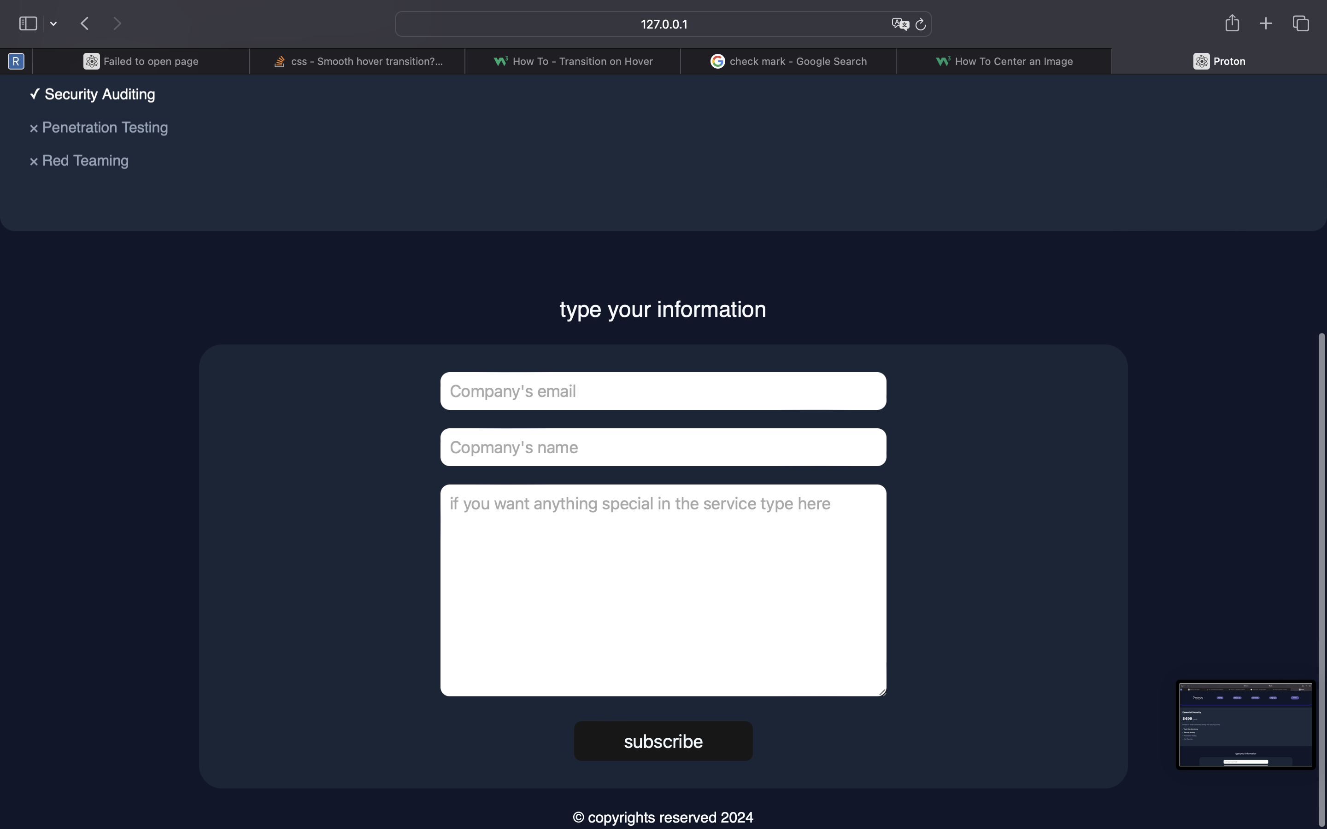

If I choosed a plan. What will happen?
1
The plan
The app will display your plan in a new page and the options again to avoid choosing the wrong plan
2
Type your information
Because we are B2B we expect companies to have special requests in cybersecurity so we made a form to take any special requests
3
A thanks page (in the next slide)
Thanks page that says the order is done and proton will contact you shortly to work with you!

Slide 8
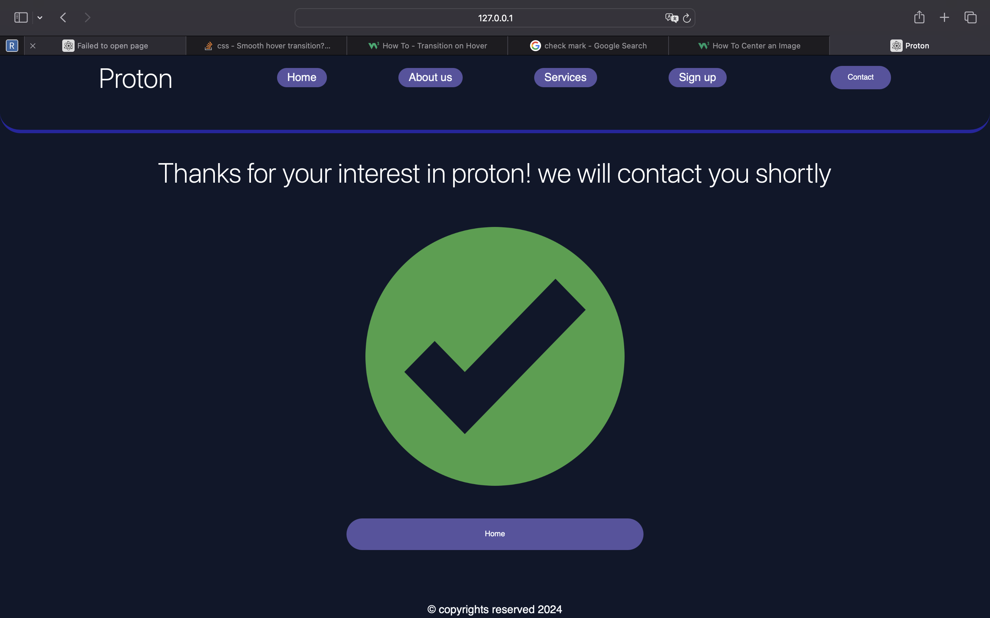


Slide 9

Conclusion: In the Realm of Cyber Chaos, Proton Brings Order.
Proton is cybersecurity services provider that protect your business. So, it’s a must to make the website look futuristic and using the latest CSS tricks and HTML tags

